Slide 1
GP Training & the MRCGP
Bradford GP Specialist Training Programme

Slide 2
An introduction to…
MRCGP
The ePortfolio
Our educational programmes
Notes:
Today I’m going to give you an overview of . . .

Slide 3

MRCGP
Getting Membership of the Royal College of General Practitioners
Notes:
Lets start with the MRCGP

Slide 4
MRCGP – what’s it all about
The assessment process for becoming a GP
MRCGP mandatory since 2007
Assesses GP competencies (what a GP should be able to DO)
Based on the RCGP curriculum (what a GP should KNOW)
Notes:
So – the MRCGP – what’s it all about? It’s the assessment process for becoming a GP and since 2007 its been mandatory for newly qualified GPs.
The MRCGP assesses GP competencies – which is really about what a GP should be able to do.
The MRCGP is based on the RCGP curriculum, which is essentially the scope of what a GP should know.

Slide 5
MRCGP
What do YOU need to do right now?
Register with the RCGP if you haven’t already done so (AiT/non-member)
Get familiar with your ePortfolio
Arrange to meet your ES and CS (Also attend the full Induction in August and the full WPBA in Aug / Sept.
Notes:
AiT membership gets you: RCGP certification, Access to the trainee ePortfolio (same as non member) but also: committee representation, part of a community, invitations to free trainee events, opportunity to apply for NUS EXTRA card, opportunity to claim tax back on all membership costs, subscriptions to the InnovAiT magazine and BJGP, access to an extensive medical library and online learning modules, discounts for major RCGP conferences, books, courses, resources and workshops.
AiT cost: initially £273.40, then £399 every April (£199.50 LTFTT)
Non-member cost: £925 for whole training, £139 for every extension year.

Slide 6
MRCGP
The Components
WPBA
AKT
CSA
Notes:
Do you know what the main components of the MRCGP are? That is – what you need to complete in order to attain the MRCGP?
There are 3 independent parts – WPBA, AKT and CSA. You must pass each of these in order to complete your training and become an independent GP.

Slide 7
MRCGP applied knowledge test (AKT)
Summative assessment of the knowledge base that underpins independent UK general practice within the context of the NHS
Tests the application of this knowledge, mapped to the RCGP curriculum
    Clinical Medicine – 80%
    Critical appraisal & Evidence based clinical practice (10%)
    Health informatics & administration (10%)
Notes:
So – the AKT. Tell me what you know about the AKT.

Slide 8
MRCGP applied knowledge test (AKT)
Computer based exam, sat in Pearson VUE Professional Testing Centres three times a year
3 hours 10 minutes to do 200 question items
Pass mark usually around 70%
Can only be taken in ST2 or later, maximum 4 attempts allowed
Costs £450

Slide 9
MRCGP clinical skills assessment (CSA)
Simulated GP surgery:
  tests ability to gather information
  apply understanding of disease processes and person-centred care appropriately in a standardised context
  make evidence-based decisions
  communicate effectively with patients and colleagues
13 cases, different patient/examiner each time, complex marking scheme
Notes:
Lets move on to the CSA. Tell me what you know about the CSA.

Slide 10
MRCGP clinical skills assessment (CSA)
Takes place in London (30 Euston Square), every month from November through to May
Costs £1325
Can only take in ST3, maximum 4 attempts
Preparation supported by scheme and trainer
Notes:
Some more information about the CSA

Slide 11
MRCGP work place based assessment (WPBA)
Provides framework for evaluating progress in those areas of professional practice best tested in the workplace
Measures what you actually do throughout your training
There are compulsory minimum requirements
Learner led and recorded in ePortfolio, reviewed every 6m by Educational Supervisor
Examined yearly by ARCP Panel (Annual Review of Competence Progression)
More details on WPBA course
Notes:
WPBA – stands for work place based assessment
Tell me what you know about WPBA

Slide 12
Mini-CEX
clinical examination exercise
CbD
case based discussions
CSR
clinical supervisor’s report
COT
consultation observation tool
PSQ
patient satisfaction questionnaire
OOH
Out of hours sessions
Components of WPBA
PDP
personal development plan
CEPS
Clinical examination & procedural skills
MSF
multi source
feedback
Log Entries
Notes:
Just to illustrate to you the range of things that are covered by the WPBA
Don’t be intimidated by all the acronyms – it might seem like a different language but you’ll get very familiar with it all very quickly

Slide 13

Notes:
I’m going to talk a little bit now about the ePortfolio specifically

Slide 14
E-Portfolio
Hands up those who've had a look?
If you haven't already - sign up and get one!!
Cannot progress through training without one
Much more demanding than F2 ePortfolio – and does get looked at!
Collection of evidence – a reflection of the kind of trainee you are
Notes:
At end of slide
I’m going to pause there and just say - I cannot emphasise enough the importance of the ePortfolio in your training
However good you might be clinically, however lovely people might tell you you are – your assessment by the ARCP panel – and therefore your progression through the training programme – is entirely dependent on the ePortfolio. If you have a good ePortfolio, you will sail through. But the opposite is also true – if you don’t engage, if you have a sparse ePortfolio – then there is a very real risk that you might not progress, and, in extreme situations, it has been the case that trainees have been released from training because their ePortfolios were so bad.

Slide 15
ePortfolio
What's it for?
For You
  Tool for your continuing professional development
  The means by which you gather data to demonstrate your competence and the window by which you display your achievements
For the ARCP Panel
  Evidence for their decision whether you can continue through training and whether you should get your CCT at the end
Notes:
So what exactly is the ePortfolio for?

Slide 16
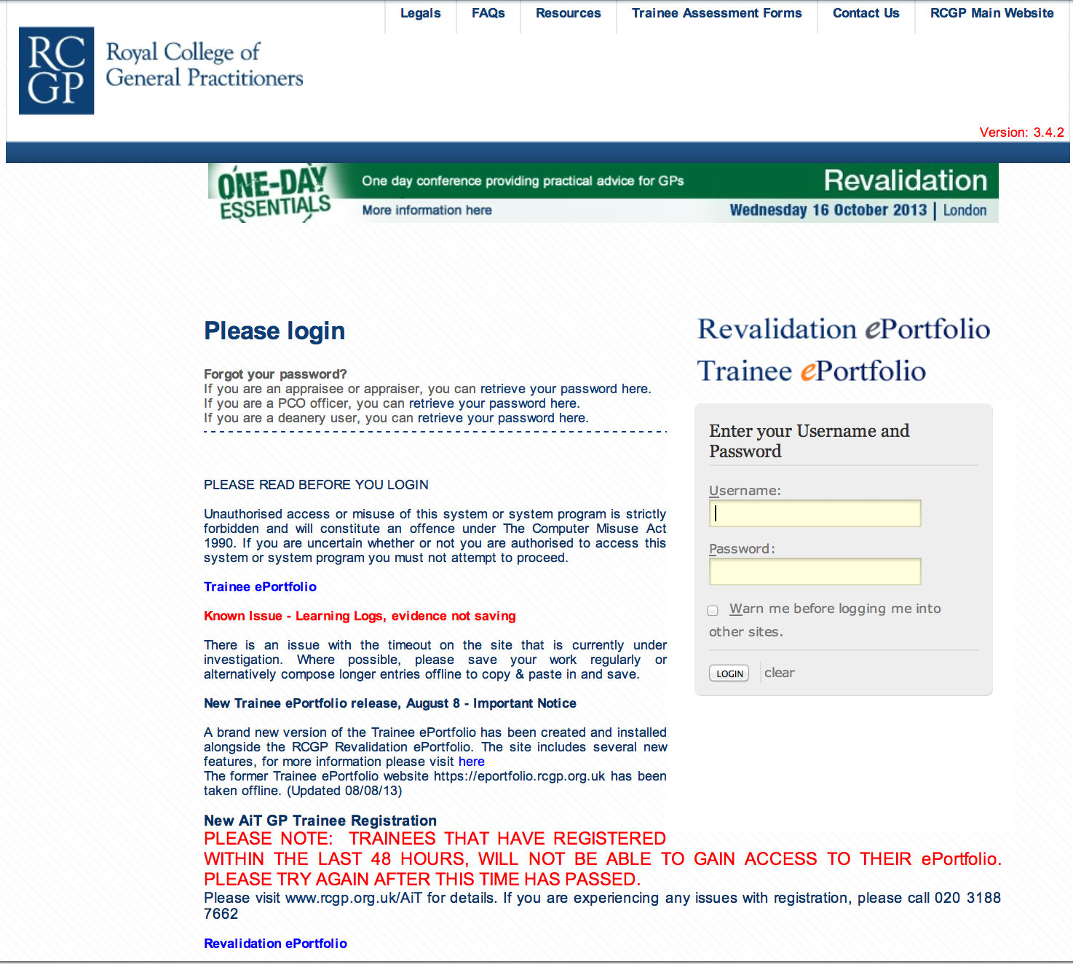
Login Page
Notes:
This is what the login page looks like

Slide 17

Home Page
Notes:
And when you log on you’ll go to your dashboard which looks something like this.
It’s all very busy and daunting isn’t it? Get stuck in, get familiar with it. You’ll soon have it figured out.

Slide 18
ePortfolio collects evidence of
MRCGP competences
Communication and Consultation Skills
Practising Holistically
Data Gathering and Interpretation
Making a Diagnosis or Decision
Clinical Management
Managing Medical Complexity
Primary Care Admin and IMT
Working with Colleagues and in Teams
Community Orientation
Maintaining Performance, Learning and Teaching
Maintaining an Ethical Approach
Fitness to Practise
Clinical Examination and Procedural Skills
Notes:
Here are the 13 RCGP competences. By the end of your training you need to have been rated competent for licensing in each of these in order to attain your CCT. Its your clinical or educational supervisor who will link your log entries to the competences. Assessments also get linked to the competences if appropriate.

Slide 19
PLEASE
Get stuck into it as soon as possible
Otherwise it will become a burden
Easier to spread the work out
The more you put it off, the harder it gets
Notes:
An earnest plea here
Please get stuck in, don’t let it build up or pile, you’re just stockpiling stress for yourself if you do that.

Slide 20
ST1-1 requirements
Log entries – reflections on clinical encounters, tutorials, lectures, significant event analyses | 1 or 2 per week
Mini-CEX (COTs in GP) | 3 in 6 months
CbDs | 3 in 6 months
MSFs | 5 in 6 months
PSQ (GP only) | 1 cycle in each GP post (40 forms)
Audit (GP only) | Complete first data collection in first GP post
CSR | 1 in 6 months
Educational Supervision Review | 1 in 6 months (end of post)
Notes:
Just to illustrate – these three years are going to be intensive, there are a lot of things to get through
In this slide I have just listed the WPBA requirements for your first 6 months
So – the key message is – be organised and proactive, get things done as soon as possible and – especially if you are in hospital posts – chase your clinical supervisors to ensure you get your assessments done. The onus is on you.

Slide 21
Have we given you enough detail?
From feedback from previous years …
  Some of you will want more at this stage
  Some of you will be overwhelmed by what we have told you so far
  We’ve aimed at the people in the middle
  Modular courses provide more detail
Notes:
I know that’s been a lot of information giving so – a small pause for breath
Was that enough detail?
There will be more information at the WPBA course and of course, there is a wealth of information on the RCGP website – and indeed our Bradford VTS website. Do have a sift through the VTS website – there’s a lot of really useful stuff on there.

Slide 22
Bradford GP Education
An Educational Smorgasbord
Notes:
Moving on to the last bit – very quickly I promise you
I’m going to talk a little bit about the GP education provided at Bradford

Slide 23
2 main aspects of learning
Learning from experience
Formal educational programmes
Notes:
It stems from our ideas about learning and us recognising that in training, there are 2 main aspects to learning
The learning you get form experience
And the learning from structured educational programmes

Slide 24
Experiential learning
Experience
Test implications
of concepts
in new situation
Observe and
reflect
Develop concepts
and generalisations
Notes:
Kolb’s cycle – anyone heard of this? Kolb was a frightfully clever chap who devised this cycle of what happens when experiential learning is occurring

Slide 25

Our Educational Programmes
Notes:
So bearing that in mind, lets move on to our educational programmes

Slide 26
The Programmes
Half Day Release - HDR - every Tuesday pm – those in GP posts must attend every session, those in hospital posts as many as you can
WPBA Course (part of Induction) - days 1 & 2 – mandatory day courses on the ePortfolio and Work Place Based Assessments
Modular Courses – mandatory for hospital based trainees but open to all.
Wednesday Tutorials for those in GP posts

Slide 27
The balance of the programme
Holistic approach and specific knowledge
Knowledge and skills and attitudes
Learning to learn, learning from each other, teaching others
Different approaches suit different people

Slide 28
WPBA Course (2 days) in Aug 18 you wihoose one date from each box
Day 1
Wed 23rd August
Wed 30th August
Day 2
Thurs 7th September
Mon 11th September
Notes:
All the new starters will be attending the WPBA course, one date from each of the boxes, and these courses just give you a crash course on WPBA and the eportfolio. Hopefully gets you off to a running start.

Slide 29
ST1 Modular Course Programme 2017-18 usually Wednesdays, venue varies
WPBA Course 2 days | August & September
Medical Ethics | January
AKT Preparation 2 days | 14.2.18 + 7.3.18
ARCP Preparation | 18.4.18
Primary Care Consultation Skills | 14.5.18
IMG Advanced Consultations Sageguarding | 22.3.18 27.4.18 21.3.18 + 10.5.18
These titles are provisional and subject to change
The dates should be timetabled into your rota
Check with your rota coordinator to ensure you are able to attend them
Notes:
The modular course programme – runs throughout the whole year – each course lasts a full day, most are repeated so you have a choice of 2 dates (IMG exception)
But you do need to organise your attendance and that responsibility is yours.

Slide 30
For those in hospital posts
Modular
courses
Add up to make the 16 half days of educational events required in each 6 month post (excluding specialty teaching)
HDR
other GP
teaching
Notes:
Just to remind you

Slide 31
Who will support you?
Clinical Supervisor – consultant or GP trainer in each post
Educational Supervisor – named trainer/TPD, usually same person through entire training – responsible for reviewing your progress via the ePortfolio, minimum once every 6 months.
TPD advisor (one of us) – to contact with any concerns and issues about your training.
We’ll email soon with TWO lists: TPD advisor and Educational Supervisor
Notes:
And that is the last information slide

Slide 32
Any Questions?

